Slide 1
CAR Champion Calibration Meeting CAR Review
Team “C”
Tovia Bat-Leah (CAR 13391183 Finding & CAR 133911731 Observation)
Jim Oates (Unable to present due to Audit commitment)
Jeff Lietz (CAR 133911586 Finding & CAR 133912110 Exemplary)

Slide 2
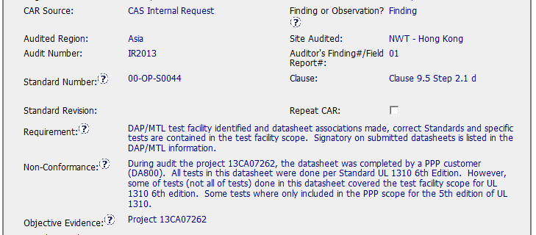
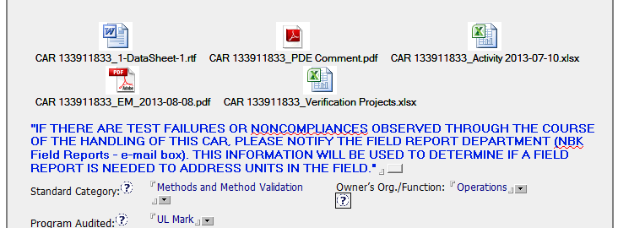
Suggestion: Specifics not outlined, requires Owner to look through files.
Good: Attachments provided
Good: Correct category, organization.
Notes:
Only suggestion for improvement would be to describe the specifics of the nonconformances, rather than requiring the Owner to go through the files to find them.

Slide 3
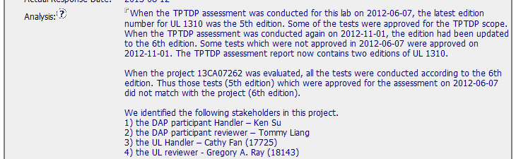
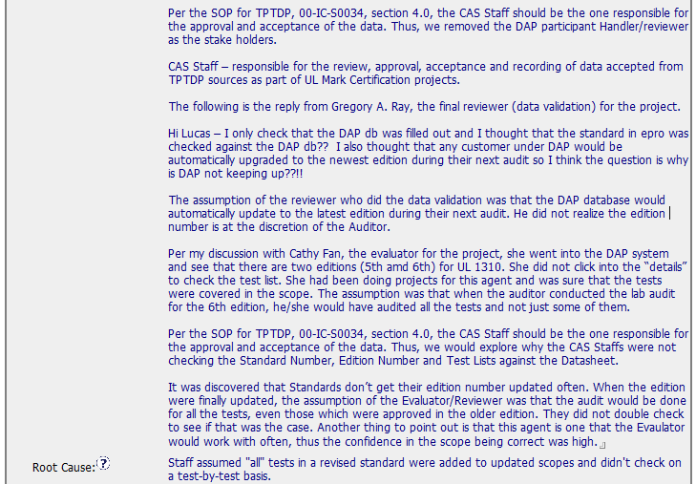
Good: Stakeholders named
Good: Relevant CAR number referenced.
Notes:
Good analysis, stakeholders named. Scope includes information about a related CAR.

Slide 4
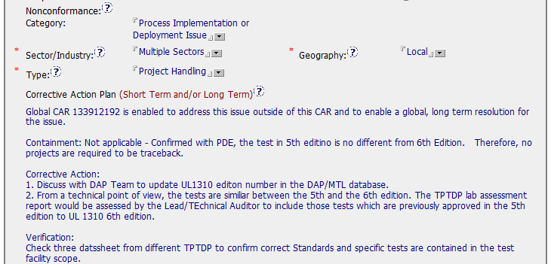
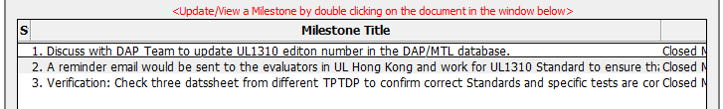
Good: Correct category, sector.
Good: Containment addressed
Milestone details on next slides. . .
Notes:
Correct category; containment addressed.

Slide 5
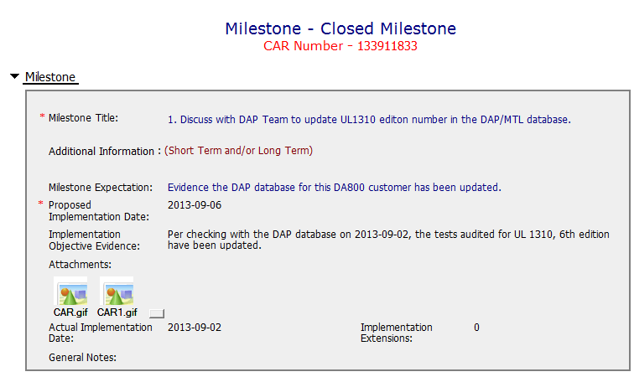
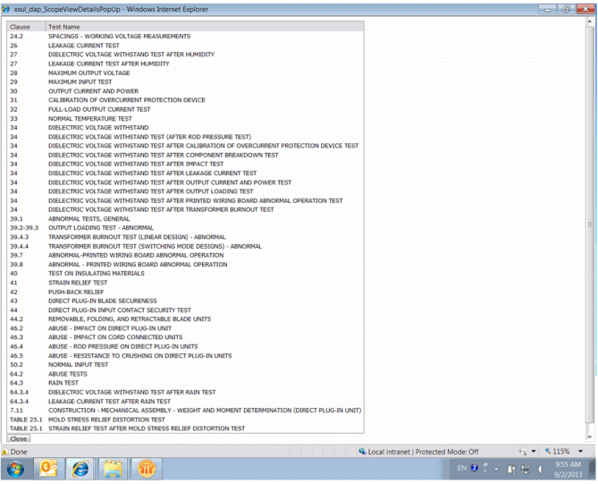
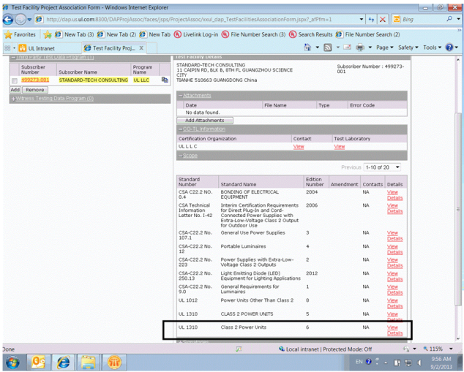
Good: Objective evidence supports closure of milestone.
Notes:
First milestone – attachments support the implementation.

Slide 6
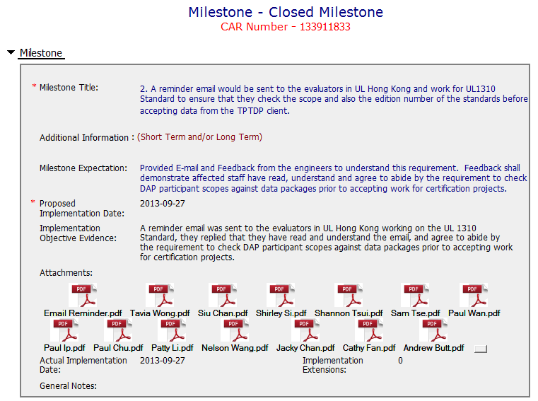
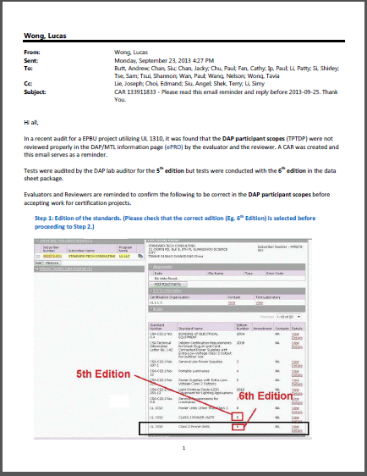
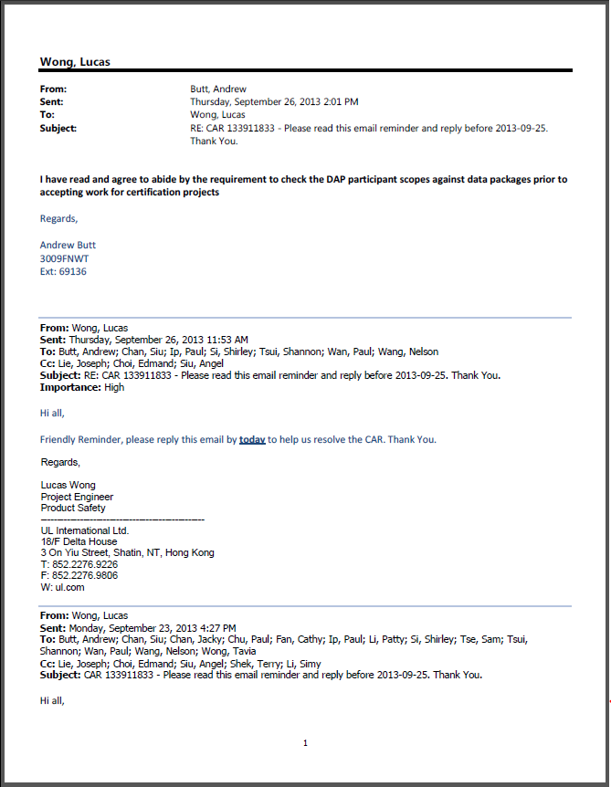
Good: Email reminder supported with confirmation that it was read and understood.
Notes:
Second milestone – attachments support implementation. Note that this is an email reminder, and there is confirmation from each recipient that they read and understood the contents of the email.

Slide 7
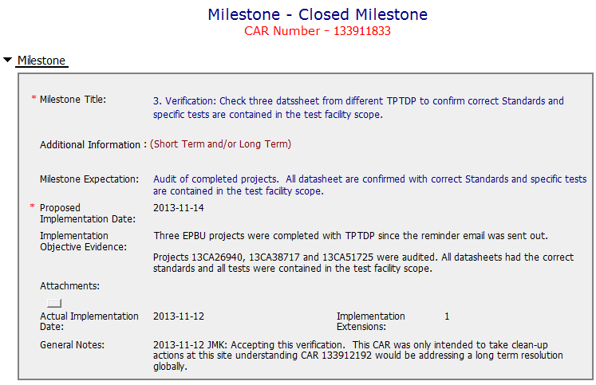
Good: Objective evidence supports closure.
Good: Indication that reference CAR addresses long-term resolution.
Notes:
Third milestone – verification. Even though this references the other CAR, verification was completed on this one.

Slide 8
History – 105 Days for a response!
Day 0 (2013/04/29): CAR Assigned to Owner
Day 14 (2013/05/13): Response submitted
Day 42 (2013/06/10): Response Disapproved But Date Changed From 2013/05/31 To 2013/07/09
Day 72 (2013/07/10): Response extension requested to 2013/08/09, approved.
Day 102 (2013/08/09): Corporate response extension requested, only a short extension approved to 2013/08/09.
Day 105 (2013/08/12) CAR Response Submitted by CAR Admin and approved
Notes:
Seems like a very long time for the response that was ultimately developed for this CAR.

Slide 9
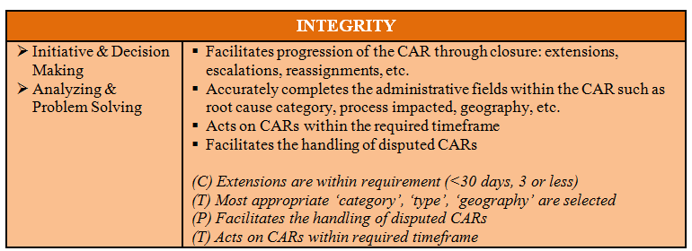
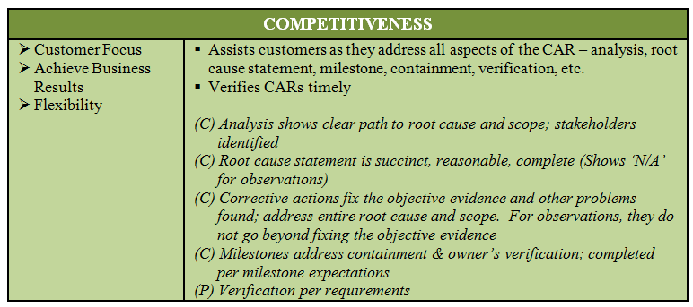
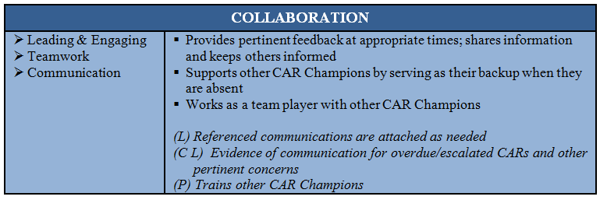
Notes:
Key CBS criteria exhibited in this CAR are the administrative fields have been completed accurately, the CAR response was very good, and the CAR was verified in a timely manner.

Slide 10
CAR Review
Team B:
Matthew Marotto, Rebeca Navarrete, Jim Kurtz

Slide 11
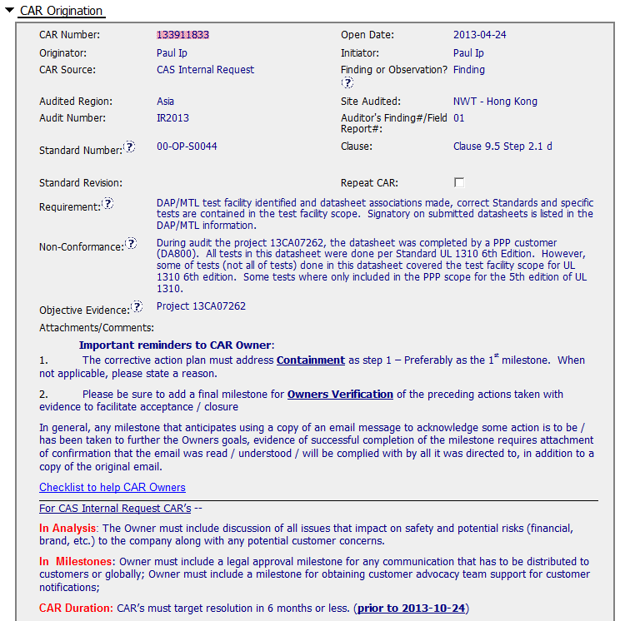
CAR 133911833
Should be referred to Clause 9.1, step 7.2.2 (Initial Assessment step not to Final Review step
Audit #?
Guidance to CAR Owner is complete, accurate and helpful

Slide 12
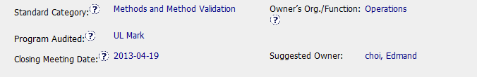
CAR 133911833
Should be referred to Preparation for Evaluation (ISO/IEC Guide 65, clause 9)

Slide 13
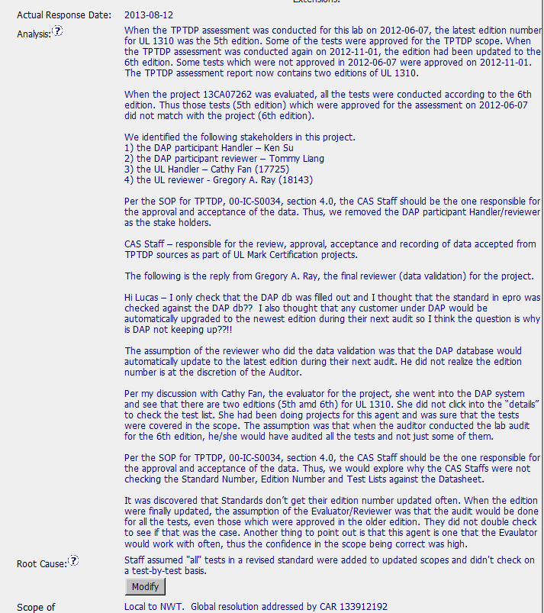
CAR 133911833
Stakeholders identified.
Analysis was not performed using the SOP referred in the Requirement field.
Root cause statement only based in personnel failure

Slide 14
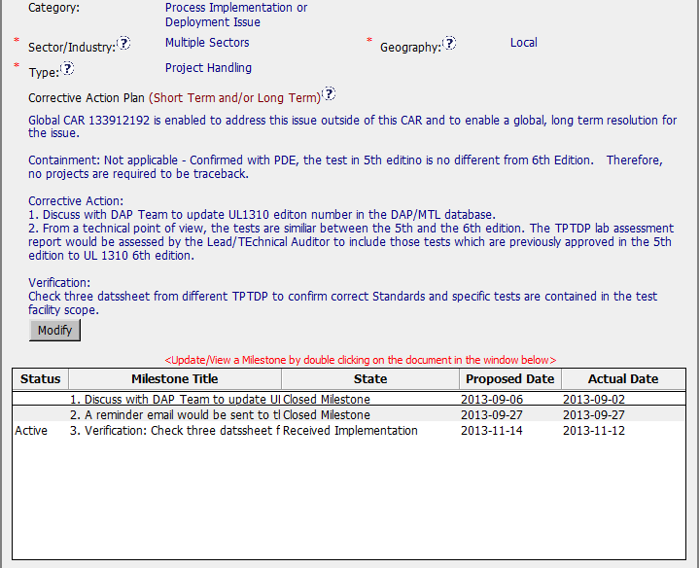
CAR 133911833
Sector should be limited to Power & Controls, applicable to the file referred in the NC
CA Plan and milestones OK

